Slide 1
heuristic algorithms for the multi trip vehicle routing problem
David Calle González 2023

Slide 2
Constructive algorithm (nearest neighbor)
capacity = Q
vehicles = R
nodes = V
autonomy = T
unvisited_nodes = nodes[1:]
While(True):
best_truck, best_node = get_best_arch(trucks_current_nodes, unvisited_nodes, truck_loads, truck_distances, autonomy)
if not best_node:
break
move_truck(best_truck, best_node)
unvisited_nodes.remove(best_node)
for every truck:
if truck has to return: //doesn’t have enough load to satisfy any node
return_to_deposit(truck)
return truck_routes, truck_distances

Slide 3
Constructive algorithm (nearest neighbor)
get_best_arch:
best_node;
best_distance;
best_truck;
for every truck:
nearest_node, distance = get_valid_nearest_node(truck_node, unvisited_nodes, truck_loads, truck_distances, autonomy)
if distance < best_distance:
best_distance = distance
best_node = node
best_truck = truck
return best_truck, best_node
get_valid_nearest_node:
valid_nodes = [node for node in unvisited_nodes if demands[destiny_node[0]] <= truck_load]
return get_nearest_node(valid_nodes)
get_nearest_node:
nearest_node
min_distance
for every unvisited_node:
if unvisited_node_distance < min_distance:
min_distance = unvisited_node_distance
nearest_node = unvisited_node
return nearest_node, min_distance

Slide 4
Greedy randomized adaptive search procedure (Grasp)
get_best_arch:
candidates = get_valid_nodes(unvisited_nodes, capacity, truck_loads, autonomy, truck_distances)
if not candidates:
return None, None
min_distance;
max_distance;
for candidate in candidates:
if candidate_distance < min_distance:
min_distance = candidate_distance
if candidate_distance > max_distance:
max_distance = candidate_distance
limit = min_distance + alpha * (max_distance - min_distance)
true_candidates = [candidate for candidate in candidates if candidate_distance <= limit]
return true_candidates[random(0, number_of_candidates)]

Slide 5
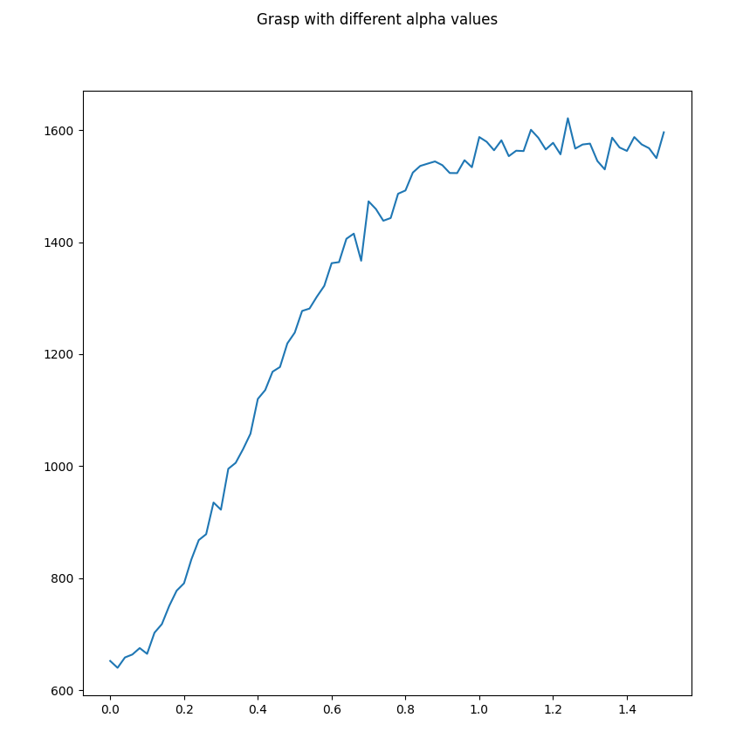
Greedy randomized adaptive search procedure (Grasp)

Slide 6
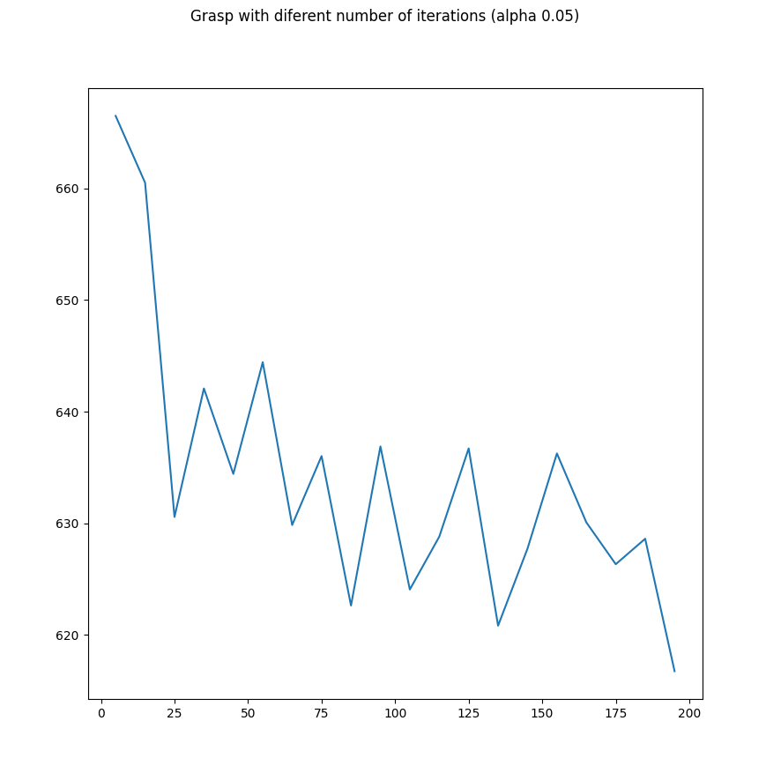
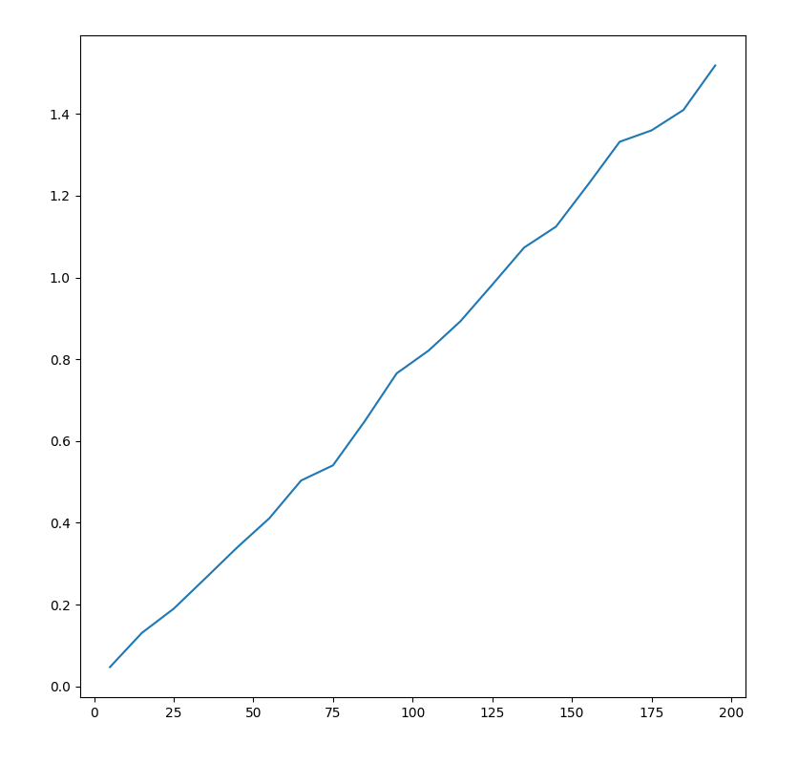
Greedy randomized adaptive search procedure (Grasp)
Grasp with different iterations (alpha 0.05)
Grasp time variation per iterations

Slide 7



Ant colony optimization (ACO)
get_best_arch:
probabilities = []
candidates = get_valid_nodes(unvisited_nodes, capacity, truck_loads, autonomy, truck_distances)
if not candidates:
return None, None
for every candidate:
probabilities.append(candidate_probability)
return random.choices(candidates, weights=probabilities)
while(not_termination)
generate_solutions()
pheromone_update()

Slide 8
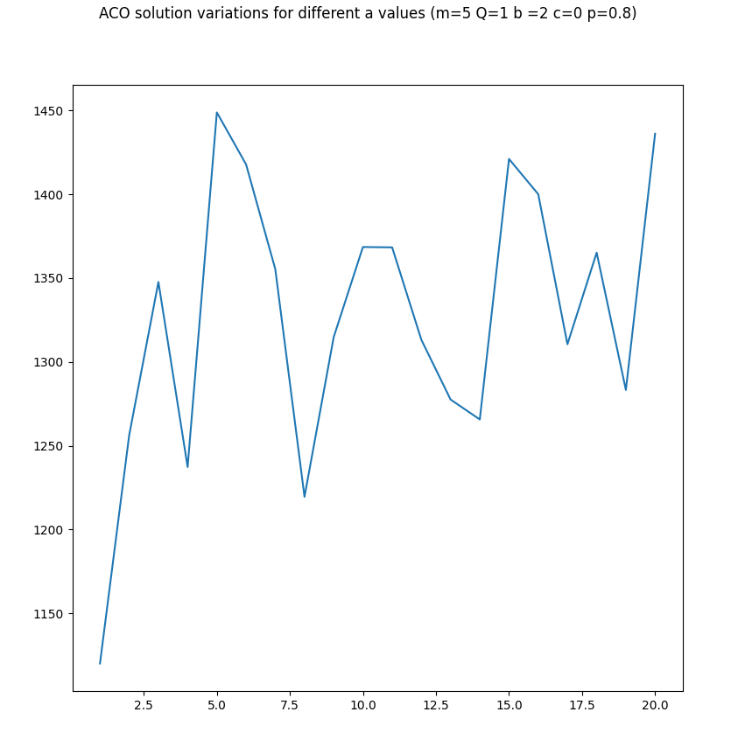
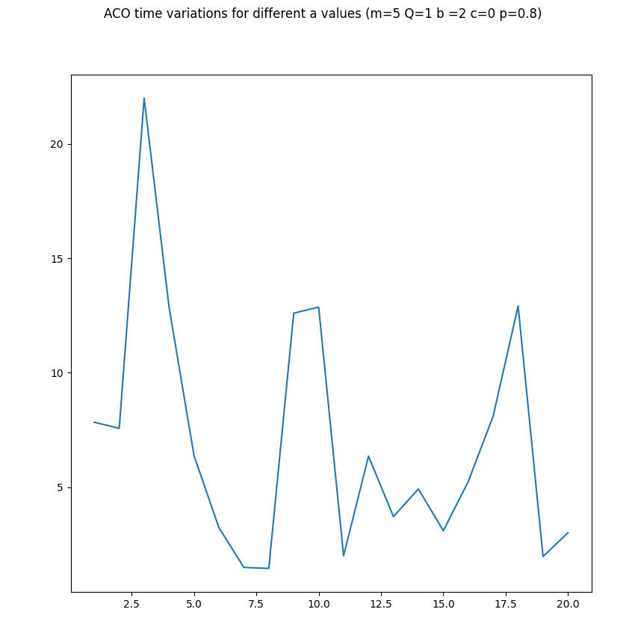
Ant colony optimization (ACO)

Slide 9
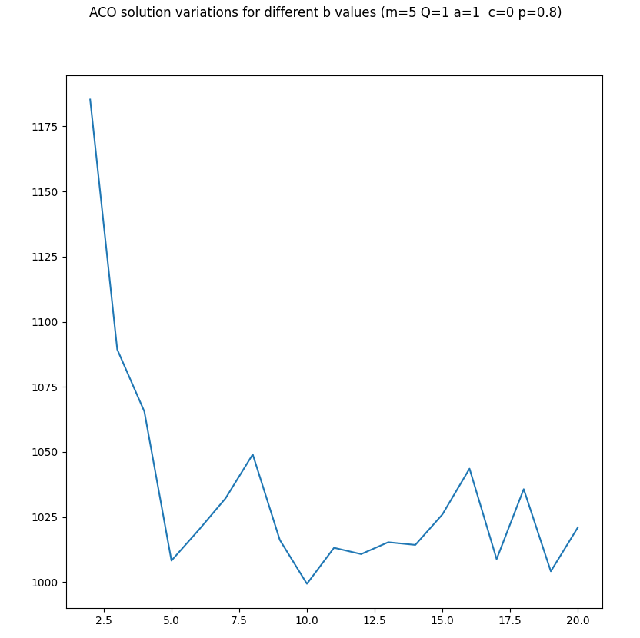
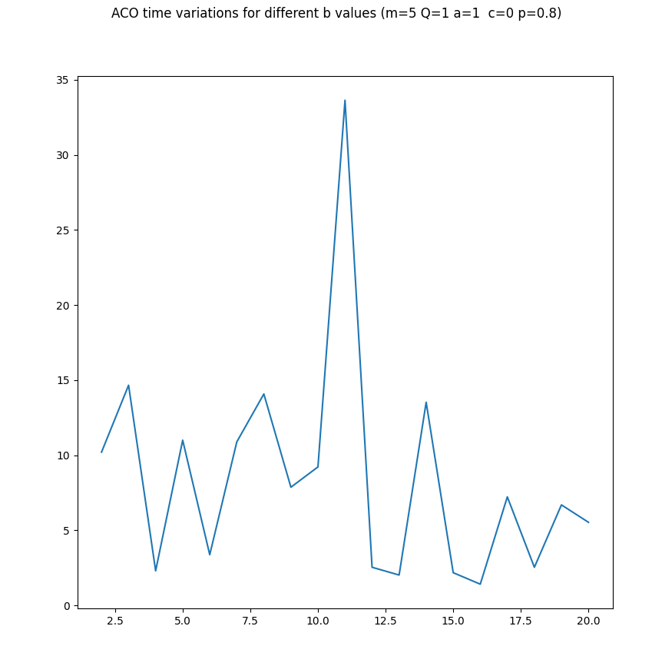
Ant colony optimization (ACO)

Slide 10
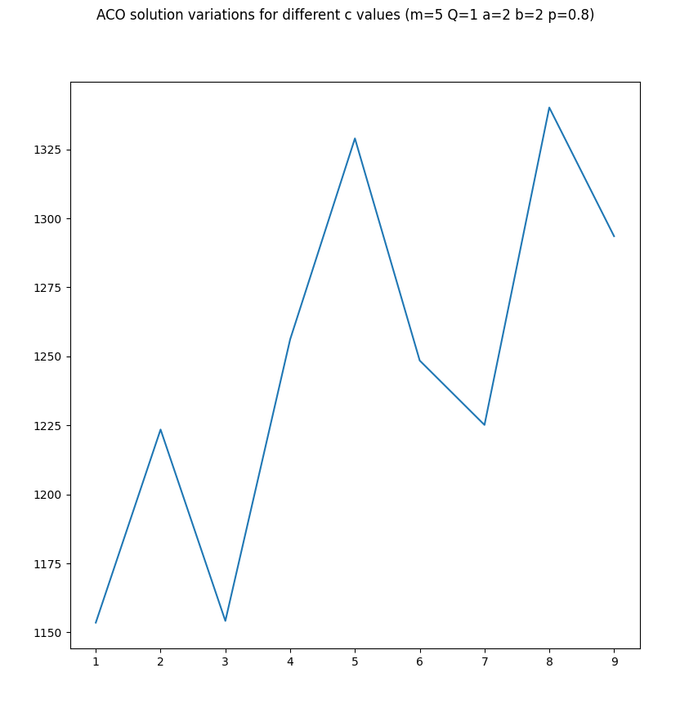
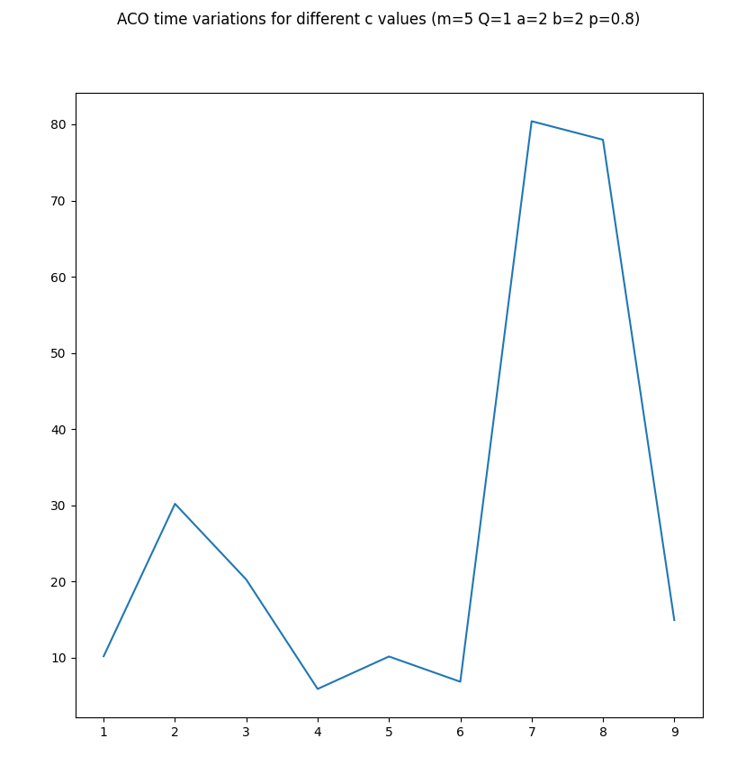
Ant colony optimization (ACO)

Slide 11
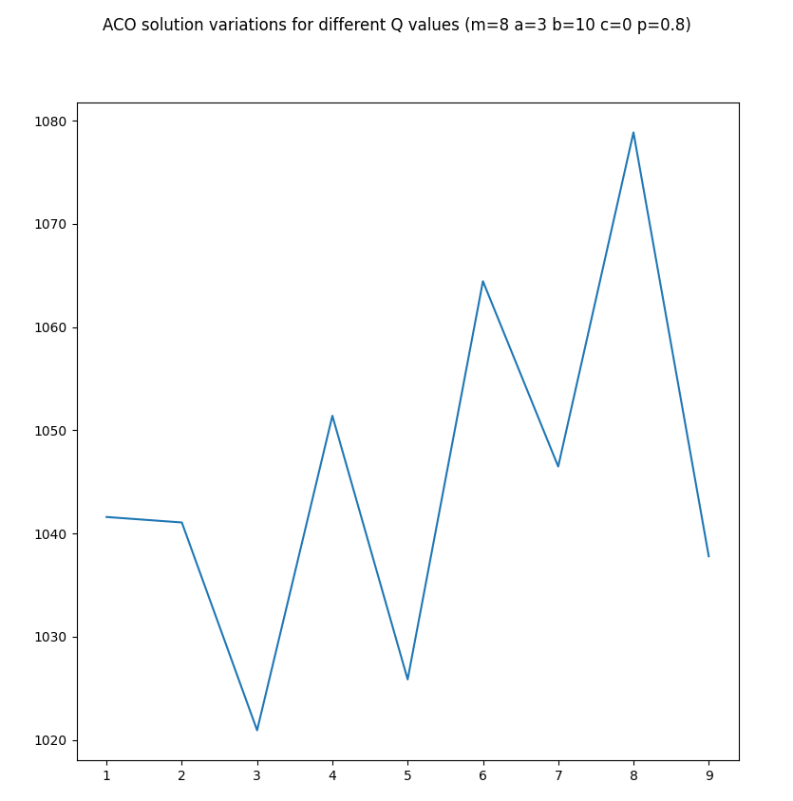
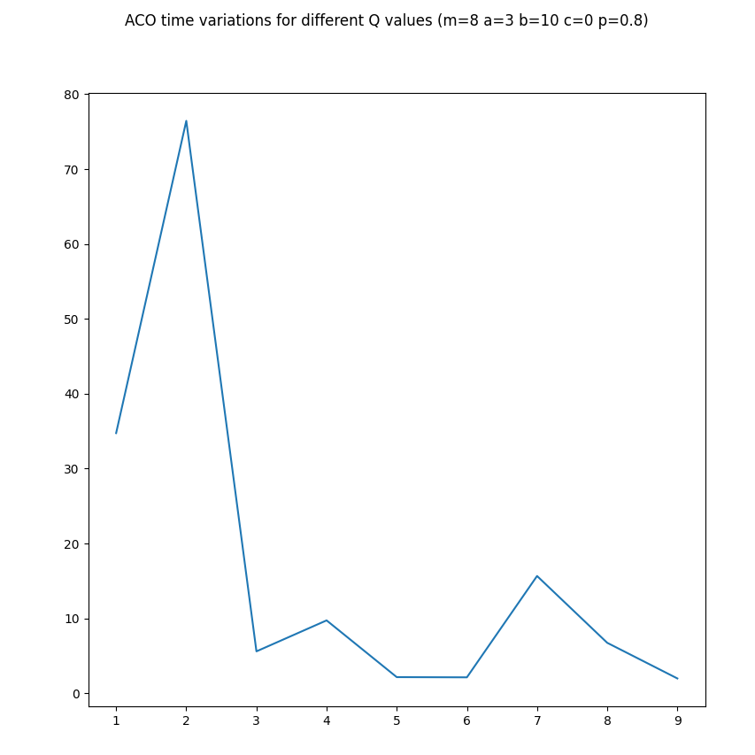
Ant colony optimization (ACO)

Slide 12
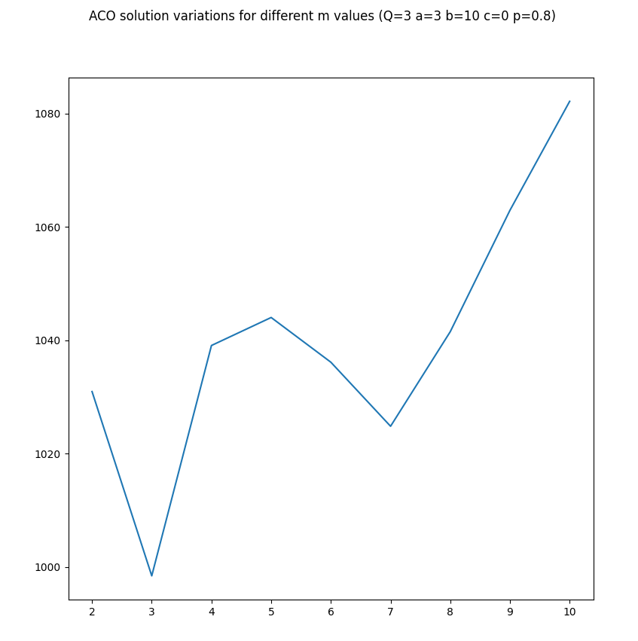
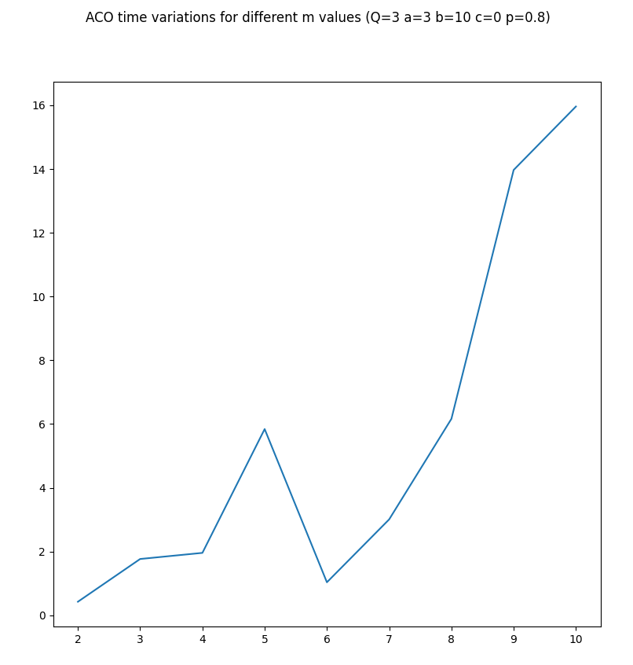
Ant colony optimization (ACO)

Slide 13
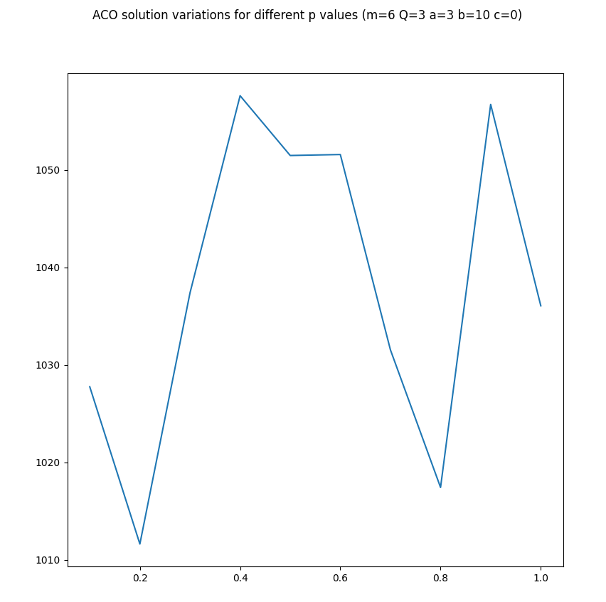
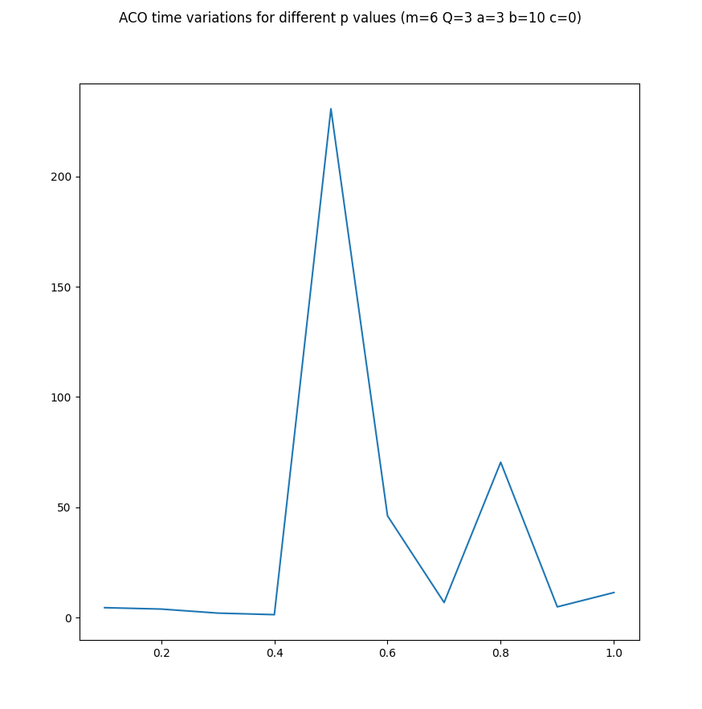
Ant colony optimization (ACO)

Slide 14
Limited ant colony optimization (LACO)
for(i = 0; i < iterations_number, i++):
generate_solutions()
pheromone_update()

Slide 15
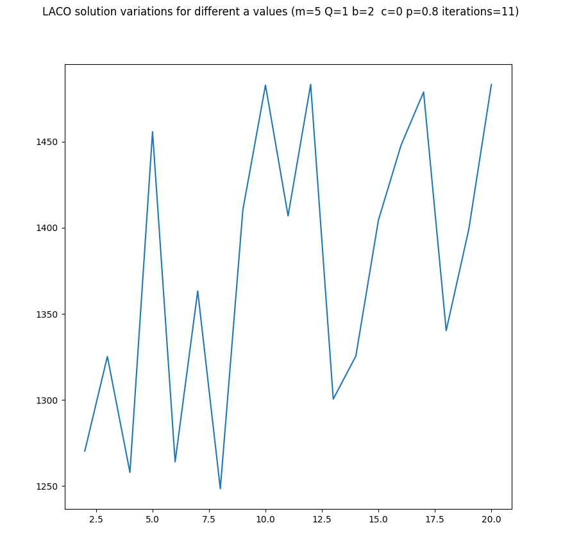
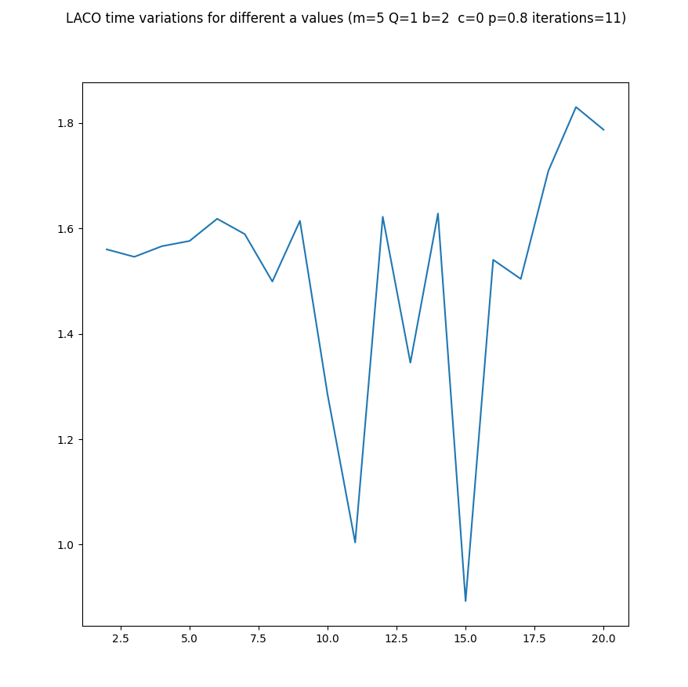
Limited ant colony optimization (LACO)

Slide 16
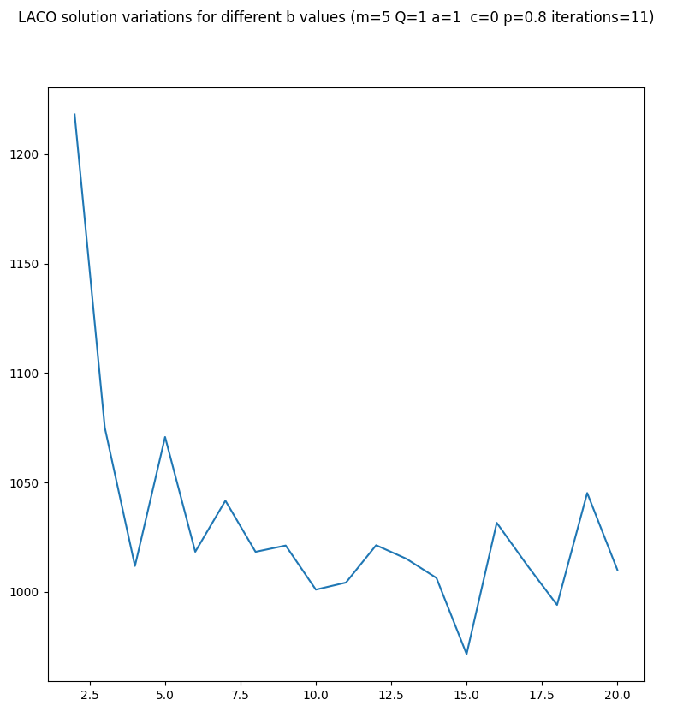
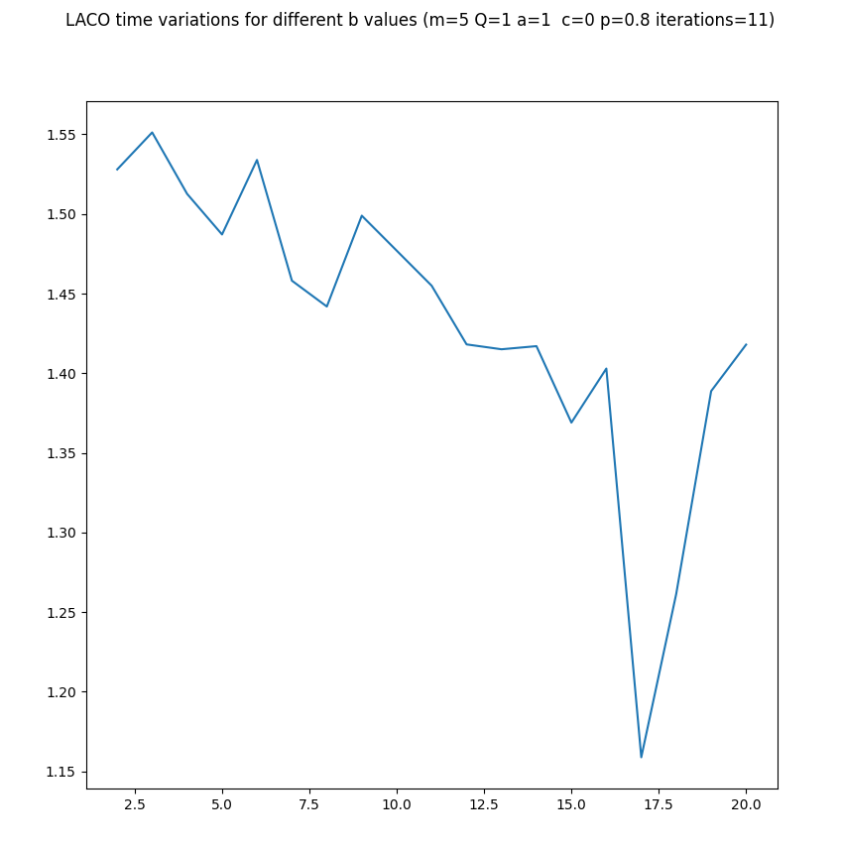
Limited ant colony optimization (LACO)

Slide 17
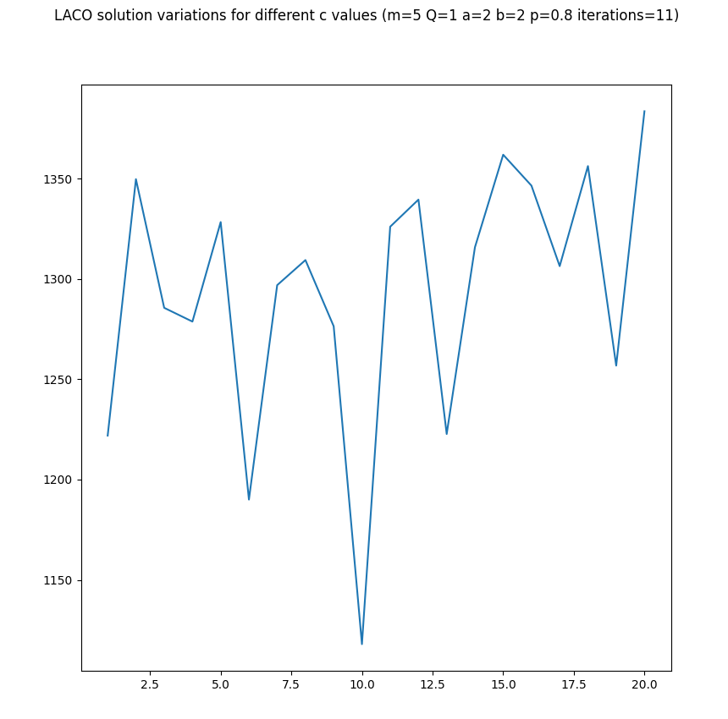
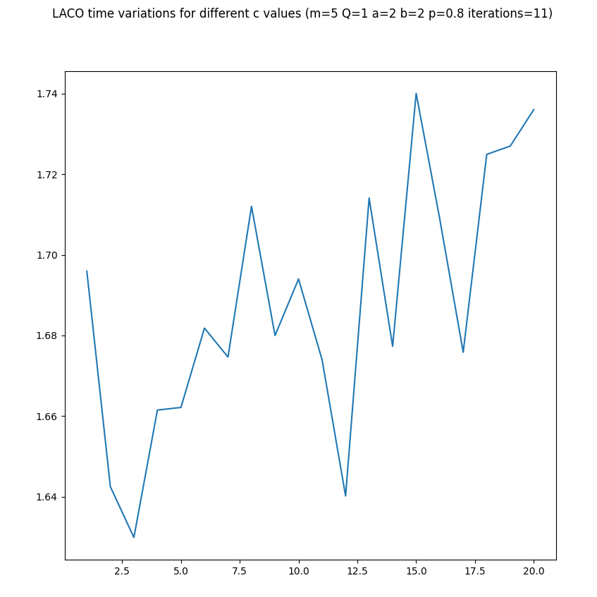
Limited ant colony optimization (LACO)

Slide 18
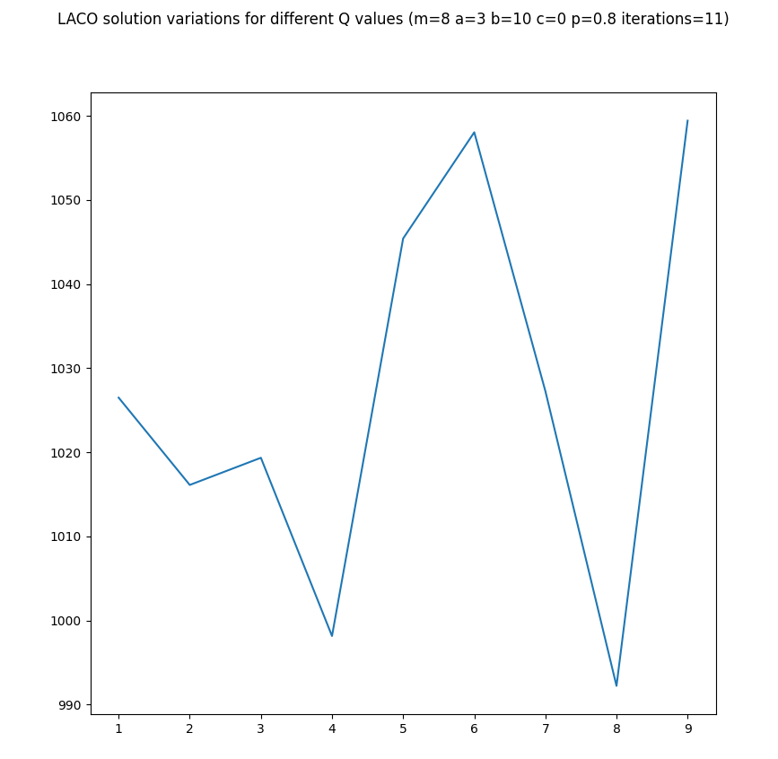
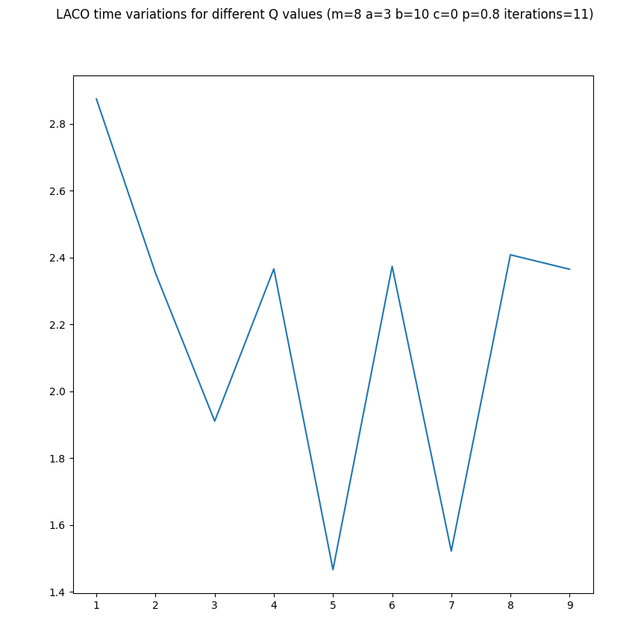
Limited ant colony optimization (LACO)

Slide 19
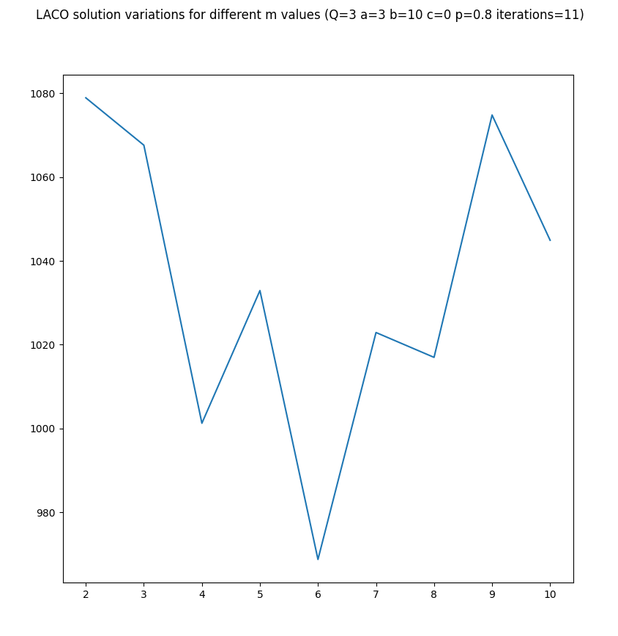
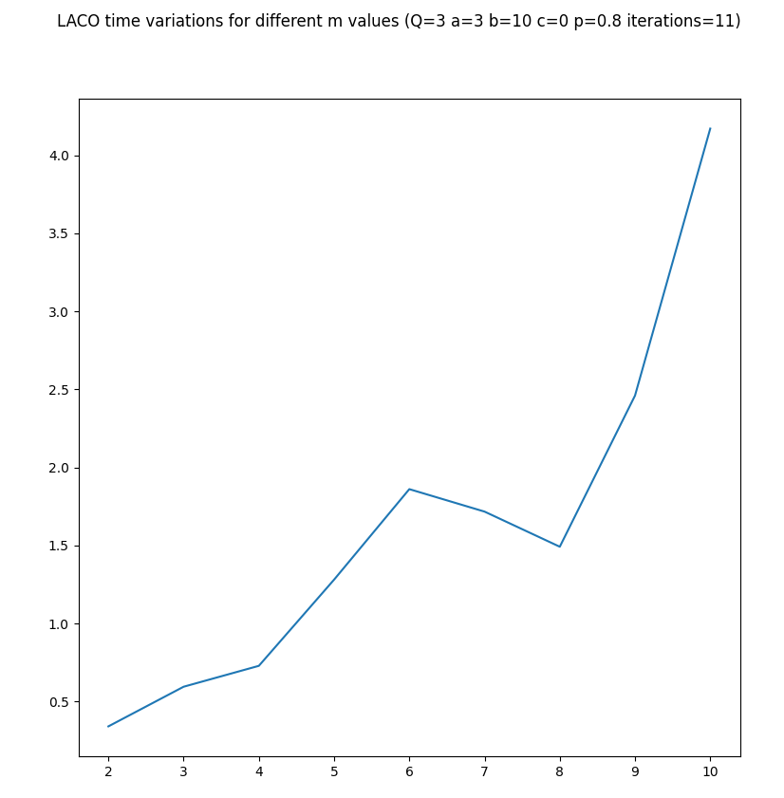
Limited ant colony optimization (LACO)

Slide 20
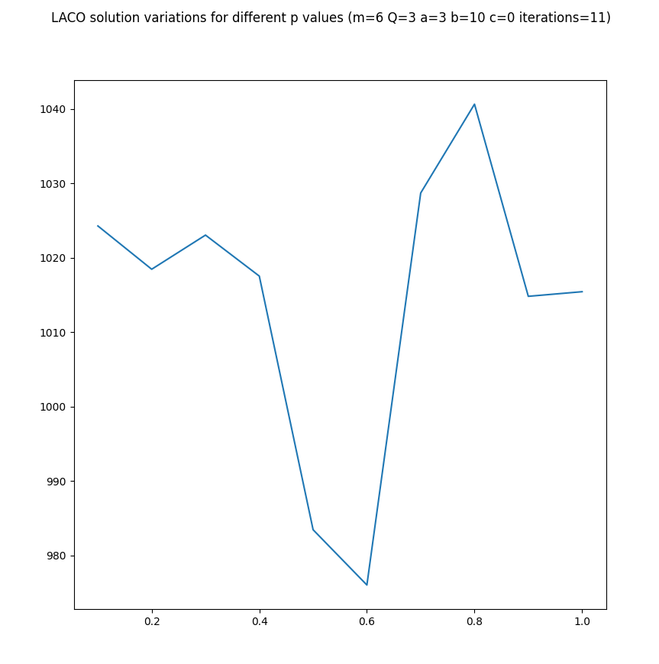
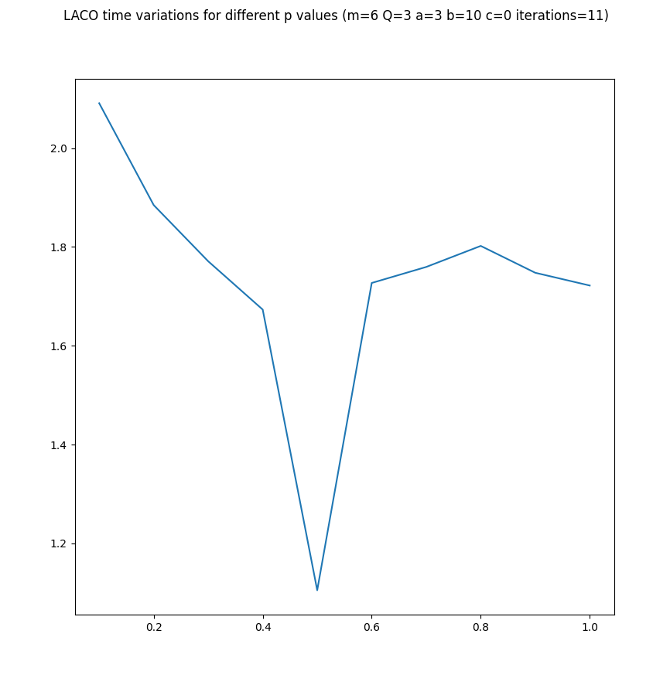
Limited ant colony optimization (LACO)

Slide 21
Noise algorithm
get_nearest_node:
nearest_node
min_distance
for every unvisited_node:
if unvisited_node_distance + random.normal(mean = 0, std = standard_deviation) < min_distance:
min_distance = unvisited_node_distance
nearest_node = unvisited_node
return nearest_node, min_distance

Slide 22
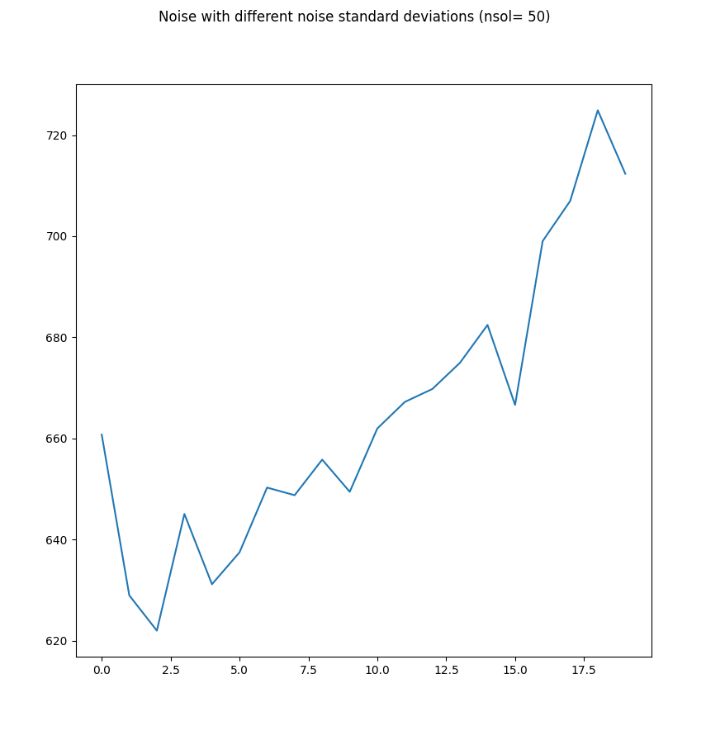
Noise algorithm

Slide 23
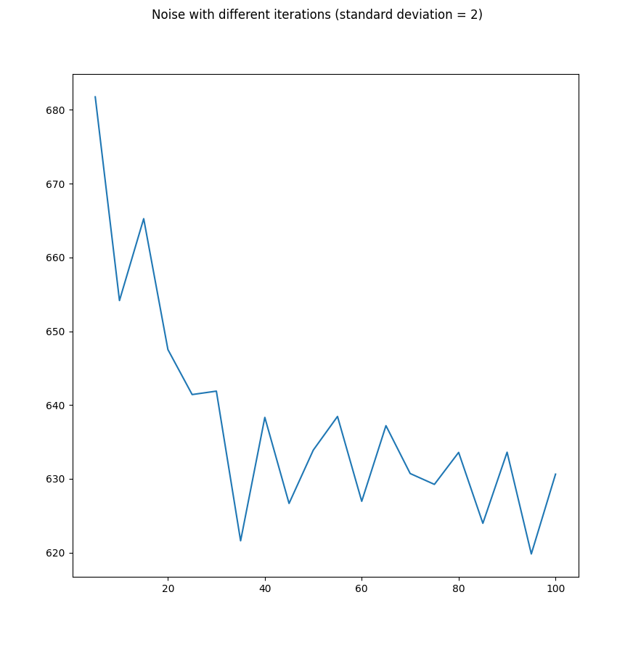
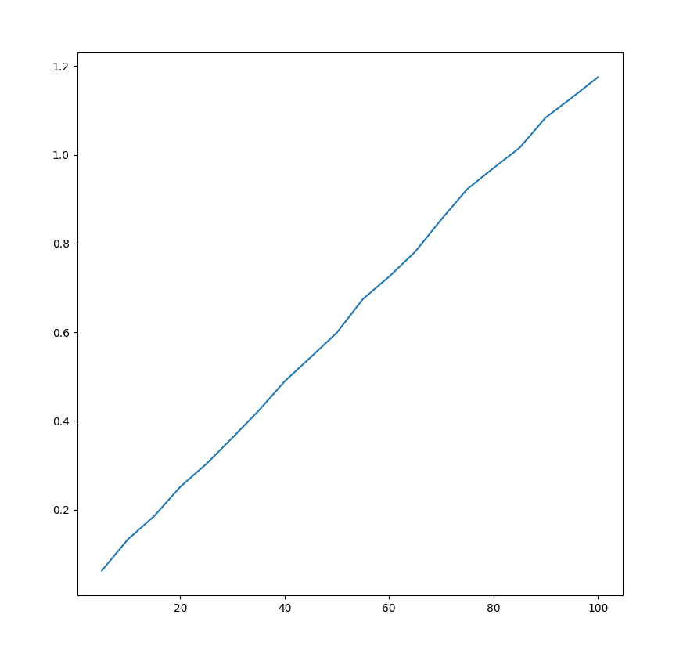
Noise algorithm
Noise Time variation for different numbers of iterations

Slide 24
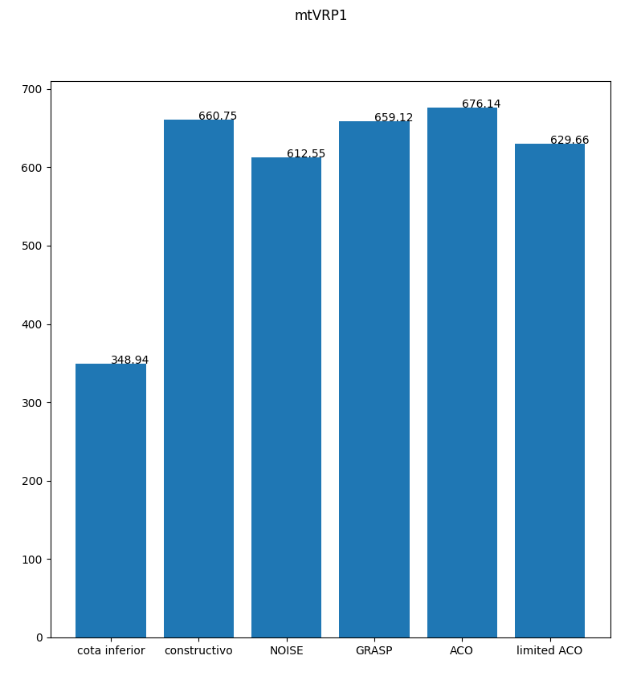
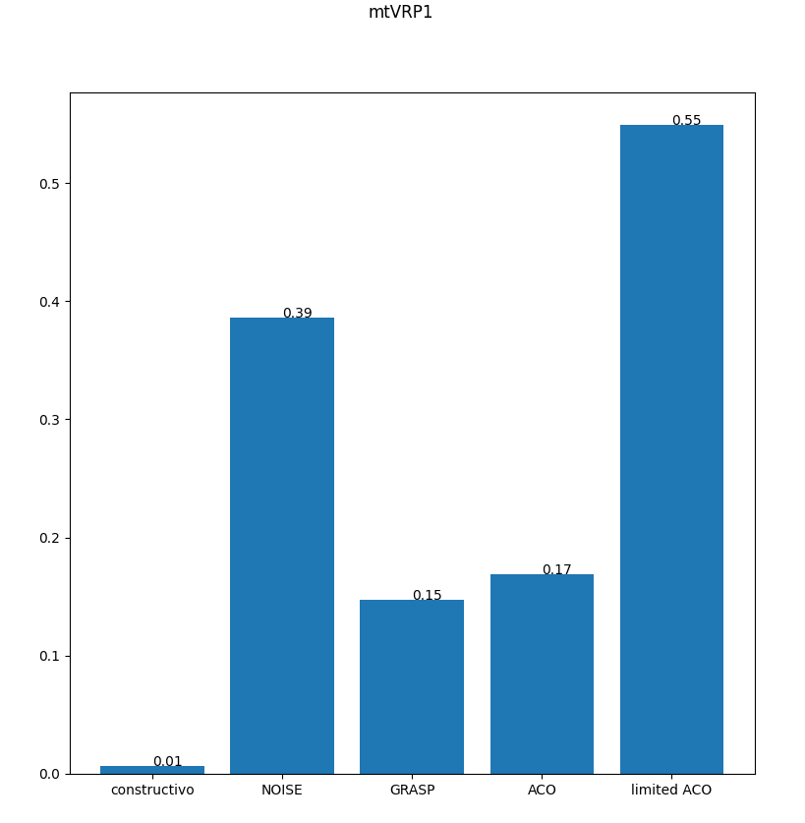
Comparación de soluciones y tiempos

Slide 25
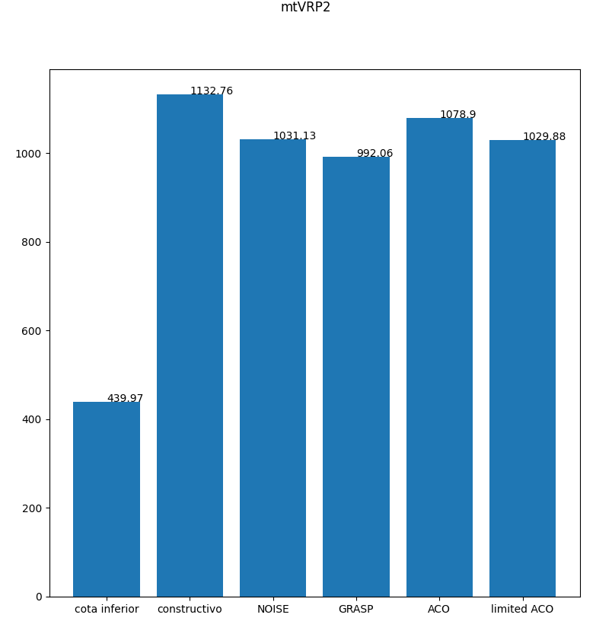
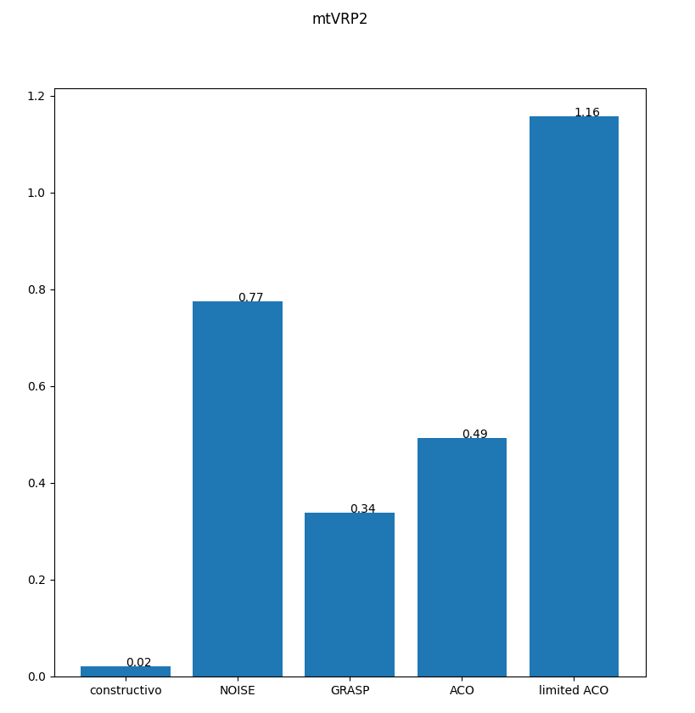
Comparación de soluciones y tiempos

Slide 26
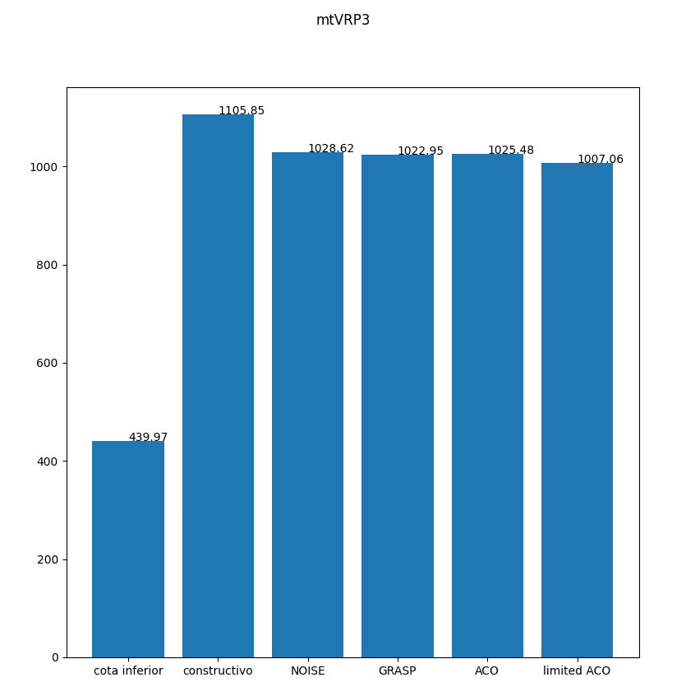
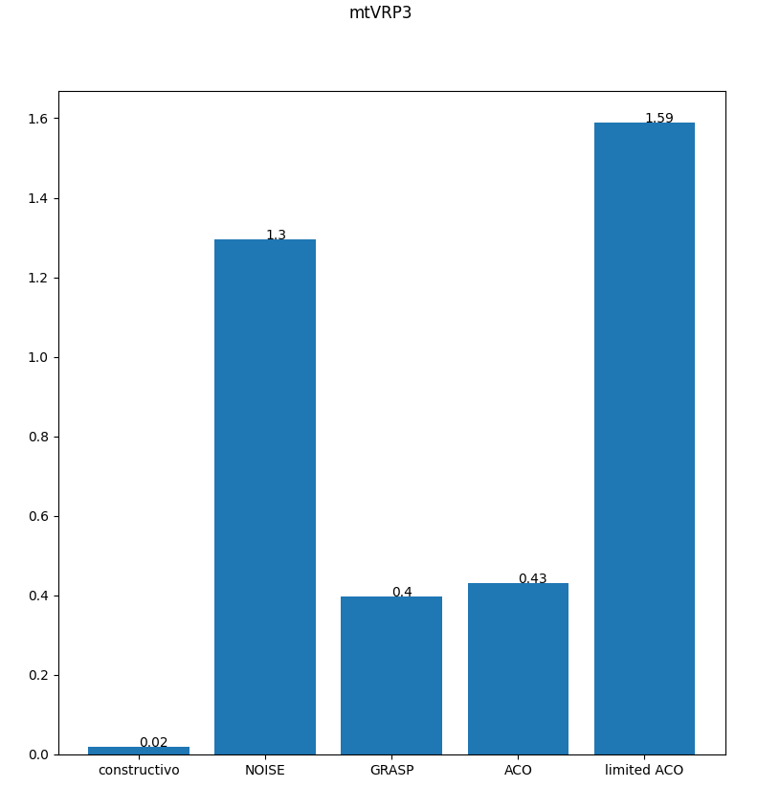
Comparación de soluciones y tiempos

Slide 27
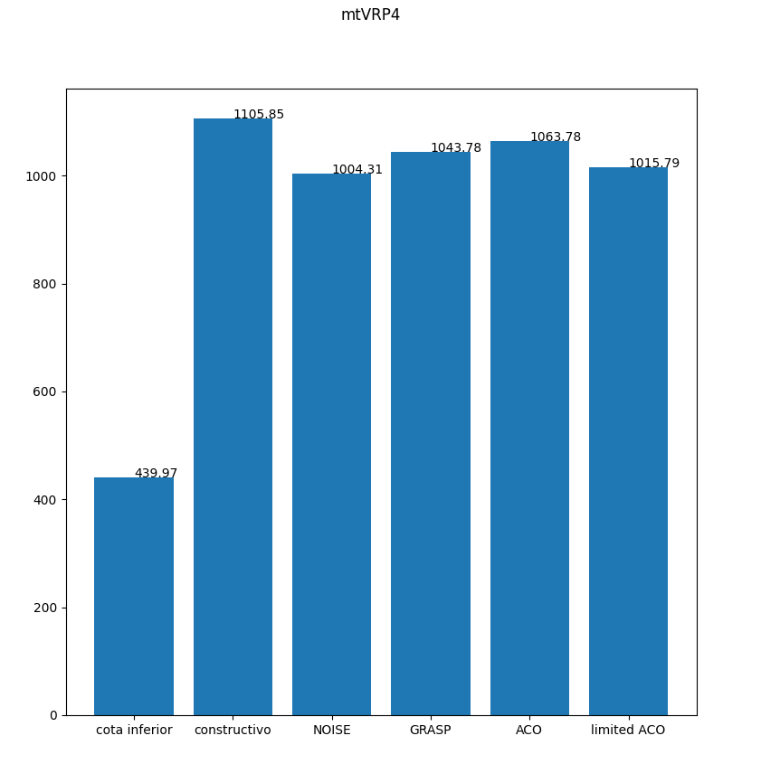
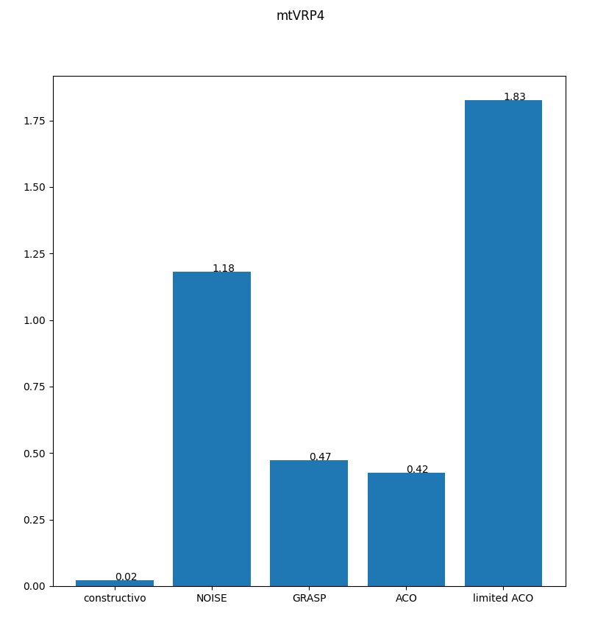
Comparación de soluciones y tiempos

Slide 28
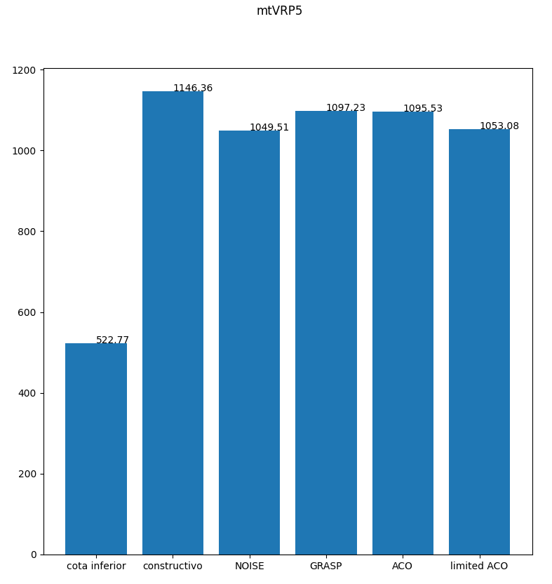
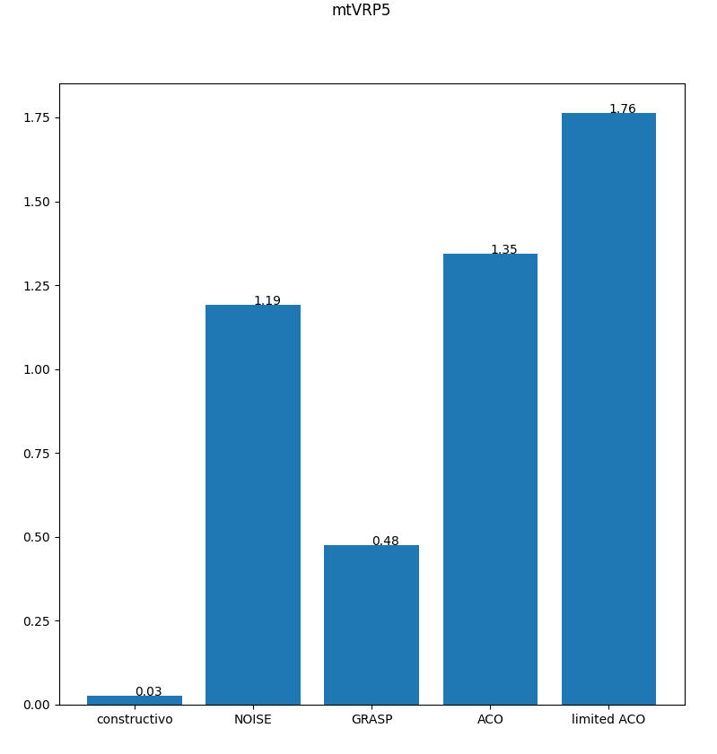
Comparación de soluciones y tiempos

Slide 29
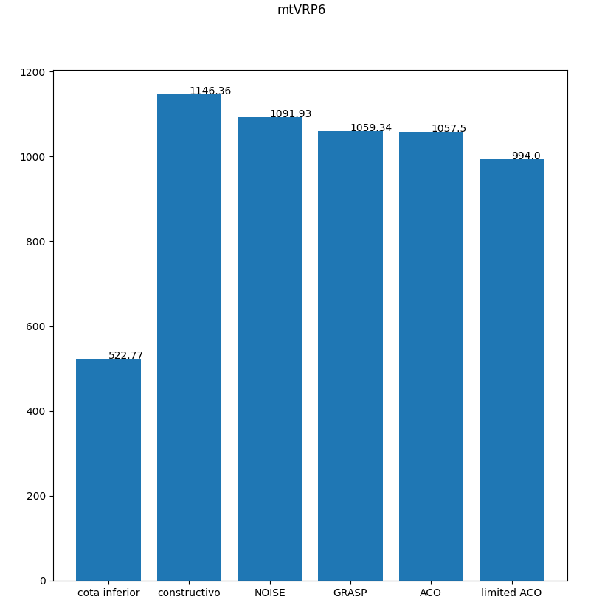
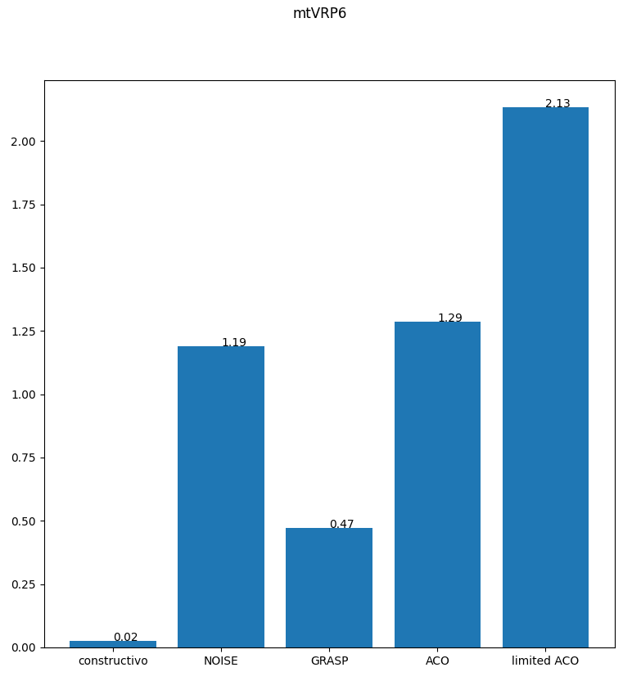
Comparación de soluciones y tiempos

Slide 30
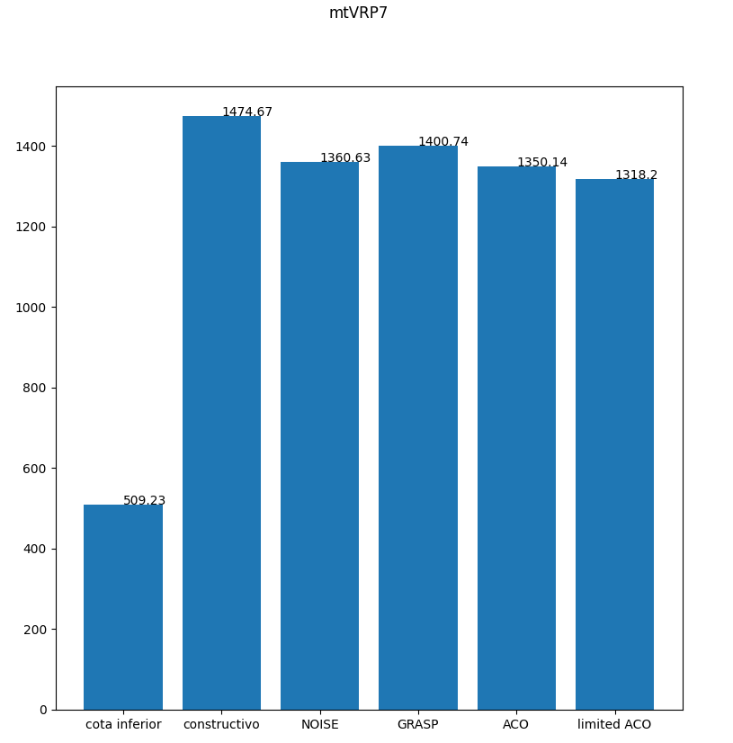
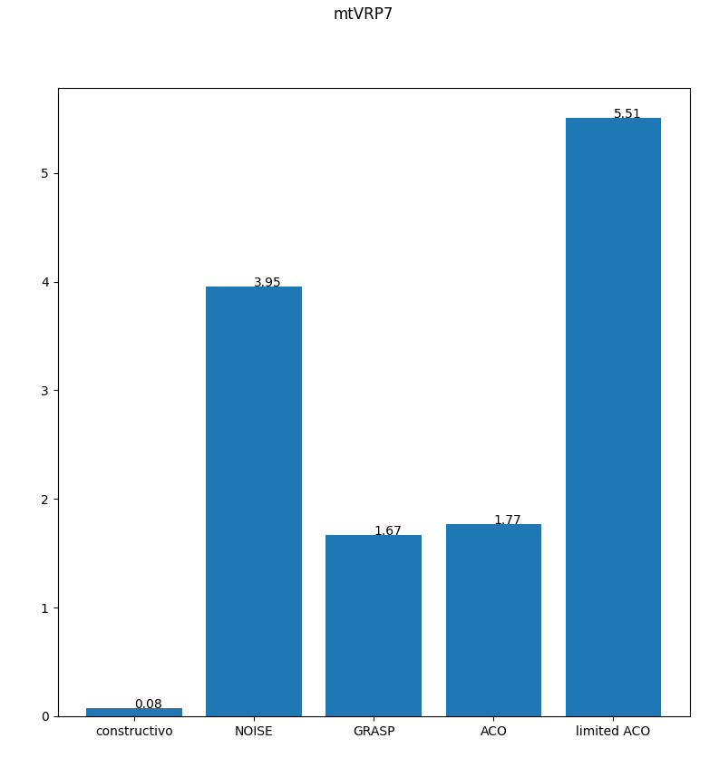
Comparación de soluciones y tiempos

Slide 31
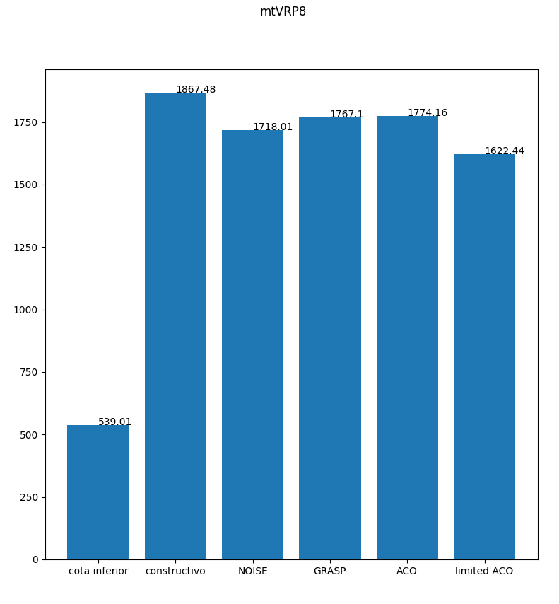
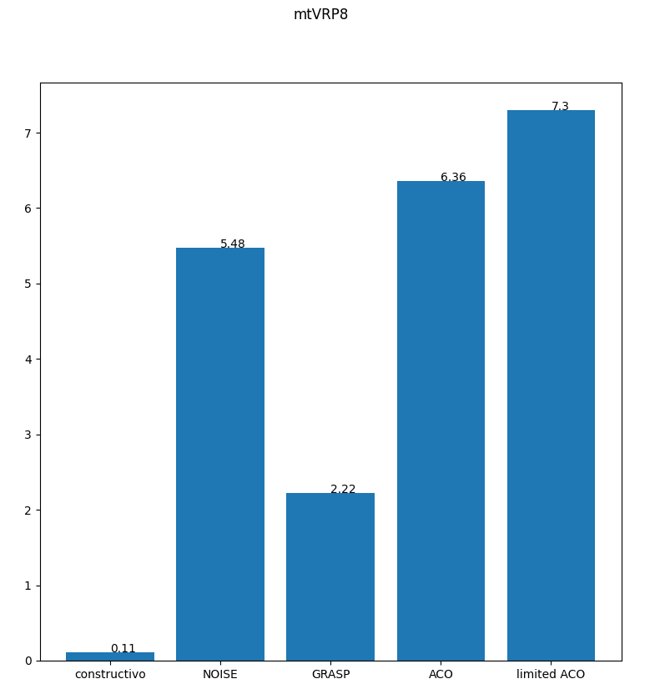
Comparación de soluciones y tiempos

Slide 32
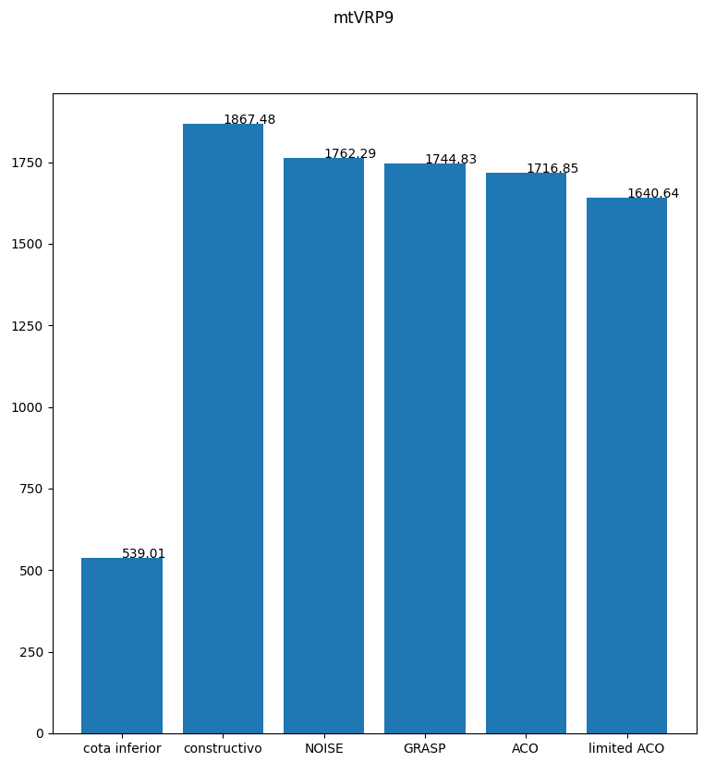
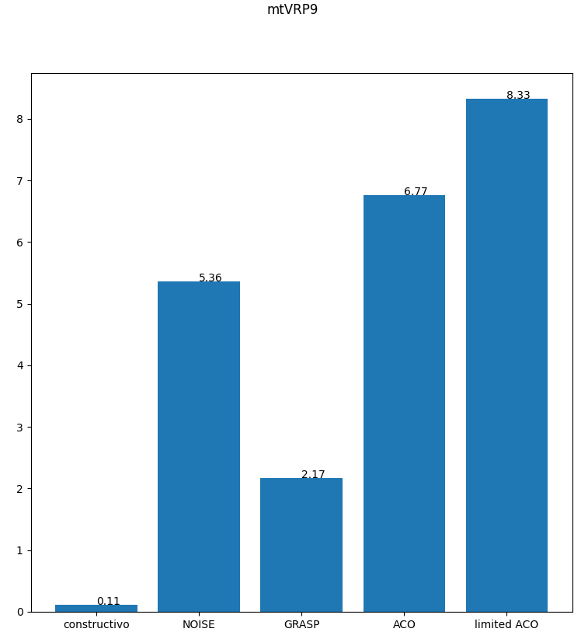
Comparación de soluciones y tiempos

Slide 33
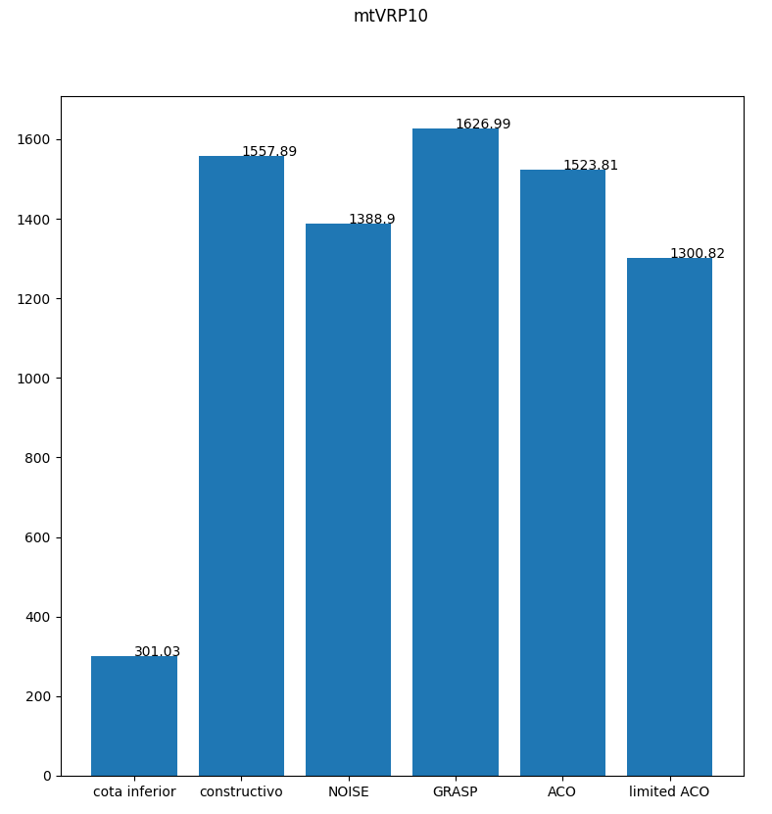
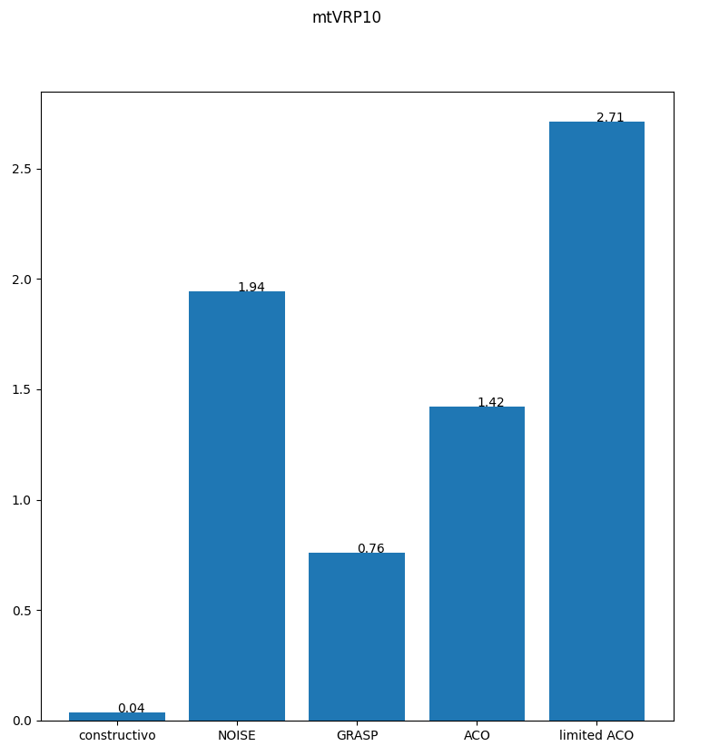
Comparación de soluciones y tiempos

Slide 34


Comparación de soluciones y tiempos

Slide 35


Comparación de soluciones y tiempos

Slide 36
Conclusiones
Los algoritmos basados en Colonia de hormigas tienen un gran potencial pero es necesario tener una buena optimización en su implementación y elegir buenos parámetros puede ser complicado.
En problemas más pequeños, GRASP y NOISE demuestran buenos resultados manteniendo un bajo tiempo de cómputo.
La cantidad de iteraciones necesarias para lograr buenos resultados en GRASP y NOISE es directamente proporcional a la cantidad de nodos.
La aleatorización, a pesar de requerir tiempo de cómputo adicional, puede efectivamente generar mejores soluciones que las de los algoritmos constructivos y por ende puede ser útil dependiendo de la necesidad.

Slide 37
Bibliografía
https://es.wikipedia.org/wiki/Algoritmo_de_la_colonia_de_hormigas
Diapositivas de clase
Links
Github Repo: https://github.com/dcalleg707/Heuristics

